Slide 1
PATHOLOGY OF BLOOD – II WBC, PLATELET & DISORDERS
R.M., SRSV

Slide 2
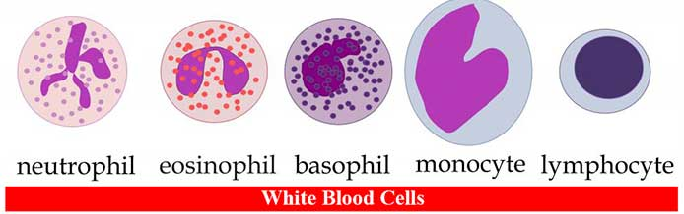
BLOOD
White blood cells (WBCs), also called leukocytes or leucocytes, are the cells of the immune system that are involved in protecting the body against both infectious diseases and foreign invaders. All white blood cells are produced and derived from multipotent cells in the bone marrow known as hematopoietic stem cells. Leukocytes are found throughout the body, including the blood and lymphatic system.
Types: granulocytes and agranulocytes.

Slide 3
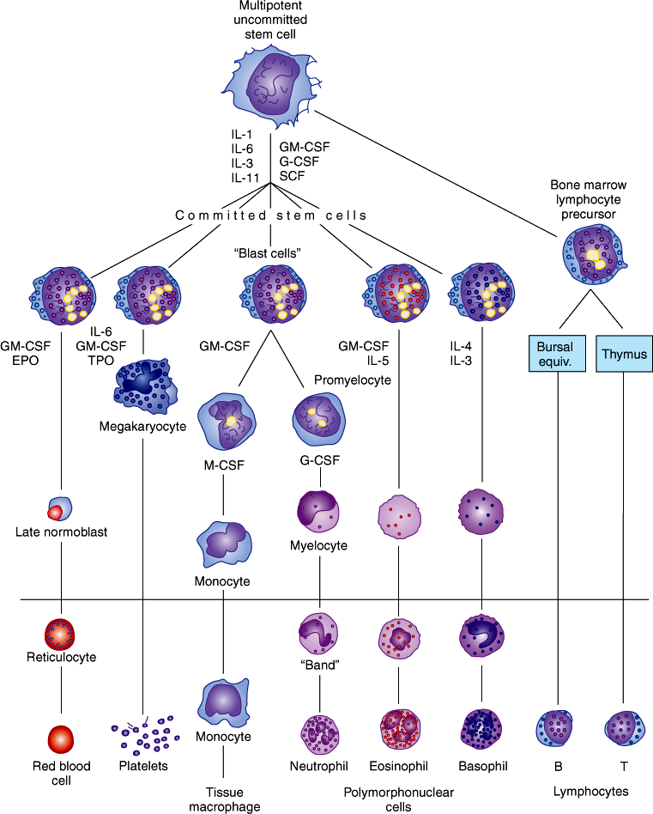
differentiation from stem cell to mature BLOOD CELLS

Slide 4
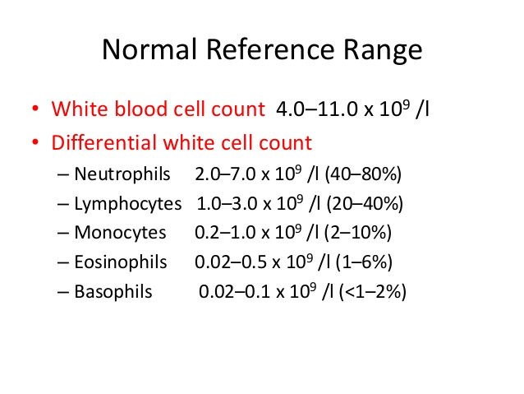
Variations in the number of white blood cells
PHYSIOLOGICAL VARIATIONS: • Age • Sex.
Diurnal variations: • Exercise • Emotional condition • Pregnancy • Sleep.
PATHOLOGICAL VARIATIONS: • Leukopania • Leukocytosis • Neutrophilia • Eosinophilia • Basophilia • Monocytosis • Lymphocytosis.
Disorders: • Leukocytosis • Leukopenia • Agranulocytosis • Neutropenia • Leukemia.

Slide 5
LEUKOCYTOSIS
Introduction: Abnormal increase in the number of circulating WBCs. • Considered to be a manifestation of the reaction of the body to a pathologic situation. • It may also occur after exercise, convulsions such as epilepsy, emotional stress, pregnancy, anaesthesia, and epinephrine administration.
Types of leukocytosis: 1. Neutrophilia (the most common form), 2. Lymphocytosis, 3. Monocytosis, 4. Eosinophilia, 5. Basophilia.
Neutrophilia: • Physiologic condition- in new born, during labour, after exercise, convulsions • Acute infections- certain bacilli, fungi, viruses, parasites. • Inflammatory conditions- Gout, Burns, Vascular disease, Hypersensitivity reactions • Intoxications- Uraemia, Poisoning by chemicals and drugs- lead, mercury. • Acute hemorrhage • Acute hemolysis • Polycythemia, myelotic leukemia.

Slide 6
LEUKOCYTOSIS
Eosinophilia: • Allergic disorders- bronchial asthma, hay fever • Skin disease- phemphigus, erythema multiforme • Scarlet fever, • Parasitic infection- malaria. • Diseases of the hemopoietic system- chronic myeloid leukemia, polycythema vera, hodgkins disease, pernicious anemia • Following irradiation • Sarcoidosis, rheumatoid arthritis.
Basophilia: • Splenectomy • Blood disease- CML, polycythemia vera, hodgkin’s anemia • Infection- smallpox, chickenpox • After injection of foreign proteins.

Slide 7
LEUKOCYTOSIS
Lymphocytosis: • Acute Infections- infectious mononucleosis, • Chronic Infections- tuberculosis, syphilis, • Lymphocytic leukemia, lymphosarcoma • Haemopoietic disorders- lymphocytosis, • Mumps, german measles, thyrotoxicosis.
Monocytosis: • Bacterial infections- tuberculosis, SABE, syphilis, • Protozoal and Rickettsial- malaria, typhus, kala-azar • CML, hodgkin’s disease, multiple myeloma • Lipid storage disease- Gaucher’s disease • Granulomatous disease- sarcoidosis, ulcerative colitis • Collagen vascular disease- lupus erythematosus, rheumatoid arthritis.

Slide 8
LEUKOPENIA
Introduction: It is a condition of decrease in the number of white blood cells (leukocytes) found in the blood, which places individuals at increased risk of infection.
CAUSES:
1) Infections: • A) Bacterial – typhoid fever, Paratyphoid fever, Brucellosis • B) Viral and Rickettsial- Influenza, Measles, Chickenpox, Dengue, Infectious Hepatitis • C) Protozoal- Malaria, Kala-azar
2) Hemopoietic disorders: • Gaucher’s disease, Pernicious anemia, Aplastic anemia, Chronic hypochromic anemia, Agranuocytosis 3) Chemical agents: • Mustards, Benzene, Urethane. • Analgesics, Anticonvulsants, Sulfonamides, Antihistamines, Anti-thyroid drugs. 4) X-ray radiations 5) Anaphylactic shock , 6) Liver cirrhosis.

Slide 9
LEUKOPENIA
Agranulocytosis (Neutropenia/Granulocytopenia): • Serious disease involving the WBC and is characterized by decrease in the number of circulating granulocytes. • The terms agranulocytosis, neutropenia, and granulocytopenia are commonly used interchangeably for a reduced quantity of leukocytes.
Types: • Primary Agranulocytosis- unknown etiology • Secondary Agranulocytosis- known etiology.
ETIOLOGY: Drugs: Antineoplastics, Antibiotics, Anticonvulsants, Antiinflammatories, Antithyroid agents, Diuretics, and Phenothiazines. Kostmann syndrome is a group of diseases that affect myelopoiesis, causing a congenital form of neutropenia, usually without other physical malformations. - manifests in infancy with life-threatening bacterial infections.

Slide 10
LEUKOPENIA- Agranulocytosis
Clinical features: • Occur at any age- particularly among adults • Women are more affected. • High fever, chills, sore throat, • Malaise, weakness • Skin appears pale and anaemic, • Presence of infections • Regional lymphadenitis, • Complication- Generalized sepsis.
Oral manifestations: • Necrotizing ulceration of the oral cavity, tonsils and pharynx particularly gingiva and palate. • Necrotic ulcers are covered by grey or even black membrane. • No purulent discharge are noted. • Excessive salivation.
Laboratory findings: • WBC are often below 2000 cells per cubic mm • Almost complete absence of granulocytes. • RBC and platelet counts are normal.

Slide 11
Leukaemia
Introduction: Leukaemia is a disease characterized by the progressive overproduction of WBCs which usually appear in the circulating blood in an immature form. • True malignant neoplasm- proliferation of WBC or their precursors occurs in such as uncoordinated and independent fashion. • Leukemic cells multiply at the expense of normal hematopoietic cell lines, resulting in marrow failure, altered blood cell counts, and, when untreated, death from infection, bleeding, or both.
Classification: • Lymphoid (lymphoblastic, lymphocytic) leukaemia- involving the lymphocytic series. • Myeloid (myelogenous) leukaemia- involving progenitor cells that gives rise to terminally differentiated cells of the myeloid series (erythrocytes, granulocytes, monocytes, platelets).

Slide 12
Leukaemia
Etiology: • Combination of environmental and genetic factors. • Certain syndromes are associated with an increased risk. These genetic disorders include the following: Down syndrome, Bloom syndrome, Neurofibromatosis, Ataxia- telangiectasia syndrome, Klinefelter syndrome, Fanconi's anemia, Myelodysplasia syndromes.
Exposure to pesticides, benzene, and benzene like chemicals, Ionizing radiation has been associated with an increased risk of developing leukemia. • Epstein-Barr Virus(EBV), Polyoma virus, Human T-cell leukemia virus-1 (HTLV-1) is known to be associated.

Slide 13
PLATELET AND ITS DISORDERS
Introduction: Platelets or thrombocytes are small colourless, non-nucleated, Spherical or rod shaped, becomes oval or disc shaped when inactivated.
Properties: 1. Adhesiveness 2. Aggregation 3. Agglutination
Normal count and its variation: • Normal platelet count- 1,50,000-4,50,000/cu mm of blood.
Physiological variation: • Age • Sex • High altitude • After meals.

Slide 14
PLATELET AND ITS DISORDERS
Pathological variation:
Thrombocytopenia: • acute infections, •acute leukaemia, •aplastic and pernicious anaemia, •chickenpox, •smallpox, •splenomegaly, •scarlet fever, typhoid, •tuberculosis.
Thrombocytosis:(known Cause) • allergic conditions, • haemorrhage, • bone fracture, • surgical operations, • splenectomy, • rheumatic fever, • trauma.
Thrombocythemia:(Unknown Cause) • carcinoma, • chronic leukaemia, • hodgkin’s disease.

Slide 15
PLATELET DISORDERS
Introduction: Platelet disorders may be divided into two categories by etiology— congenital and acquired.
Two additional categories by type—thrombocytopenias and thrombocytopathies.
Thrombocytopenias: occur when platelet quantity is reduced and are caused by one of three mechanisms:
1. decreased production in the bone marrow,
2. Increased sequestration in the spleen, or
3. accelerated destruction.

Slide 16
PLATELET DISORDERS
Thrombocytopathies: (or qualitative platelet disorders): Characterized by dysfunctional platelets (thrombocytes), which result in prolonged bleeding time, defective clot formation, and a tendency to haemorrhage.
May result from defects in any of the three critical platelet reactions:
1. Adhesion,
2. Aggregation, or
3. Granule release.

Slide 17
Congenital coagulopathies
Haemophilia: • Blood disease characterized by prolonged coagulation time and haemorrhagic tendencies. • Hereditary disease, defect being carried by X-chromosome, • Transmitted as a gender-linked Mendelian recessive trait. • Occurs only in males, transmitted through an unaffected daughter to a grandson.
Etiology: HemophiliaA: Disorder of Plasma Thromboplastinogen (AHG factor VIII) • Hemophilia B: Disorder of Plasma Thromboplastin component (PTC factor IX) • Hemophilia C: Disorder of Plasma Thromboplastin antecedent (PTA factor XI).

Slide 18
Congenital coagulopathies
Haemophilia A: • A deficiency of F VIII, the anti-haemophilic factor, is inherited as an X-linked recessive trait that affects males. The trait is carried in the female without clinical evidence of the disease. Clinical signs: • hematomas, hemarthroses, haematuria, • gastrointestinal bleeding, and • bleeding from lacerations • head trauma or spontaneous intracranial bleeding • Joint synovitis, haemophilic arthropathies • Intramuscular bleeding and pseudo-tumors.

Slide 19
Congenital coagulopathies
Haemophilia B: • Due to PTC deficiency also known as Christmas disease. • 2 forms- apparently normal levels of the inactive protein and another in which there is deficient level of the coagulant factor.
Haemophilia C: • it is transmitted as an autosomal dominant trait. • Bleeding symptoms do occur but are usually mild.
Oral manifestations: • Gingival Haemorrhage- massive and prolonged • Pseudo-tumour.
Laboratory findings: • Prolonged coagulation time • Bleeding time- normal • PTT is prolonged.

Slide 20
THANKS
SHOW ENDED.

